Slide 2
Set Your Sites
Retail Space vs. Online Stores

Slide 4
Create Heat Maps to Find Saturated Markets

Slide 5
Find Spending Trends in Your Neighborhood

Slide 6
Size your Market and Map demand for your area

Slide 7
Analyze specific locations by address

Slide 8
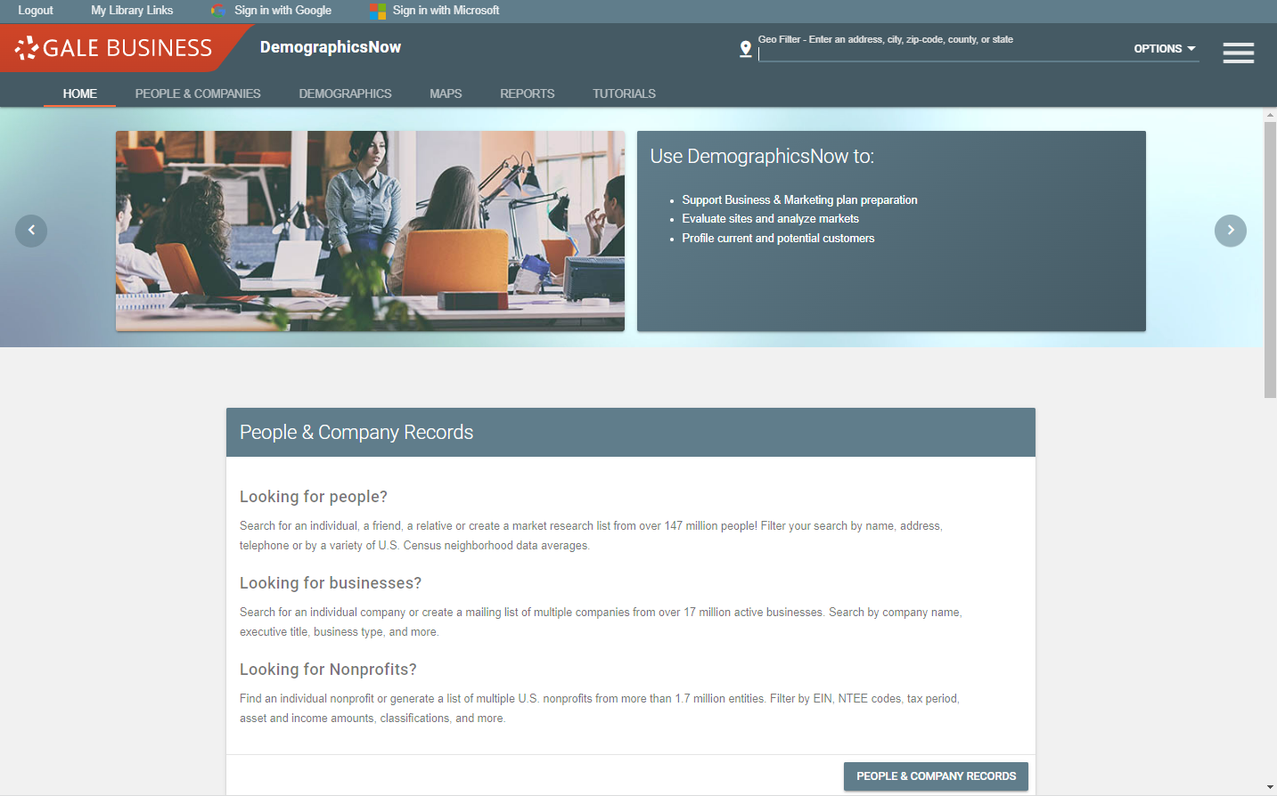

Slide 9
Step 1:

Slide 10
Step 2:

Slide 11
Find an individual
Create a market research list
Search by name, address, or Census data

Slide 12
Compare statistics from multiple geographies
Summarize information on geographic information
Rank multiple geographies

Slide 13
Create heat maps
Add layers to the map based in demographic variables

Slide 14
Assess Market Risk
Business Site Prospector
Compare Local Markets
Market Demand Map
Size Your Market

Slide 15
Learn more about how to use this tool straight from the product developer

Slide 16
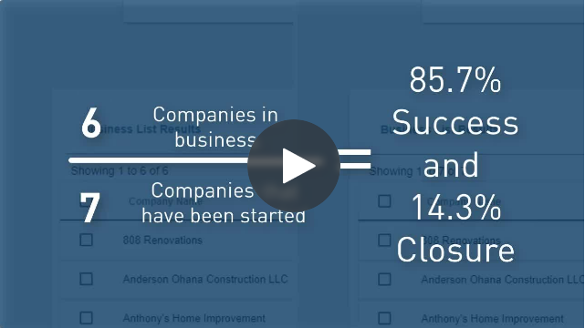
Assessing Market Risk

Slide 17
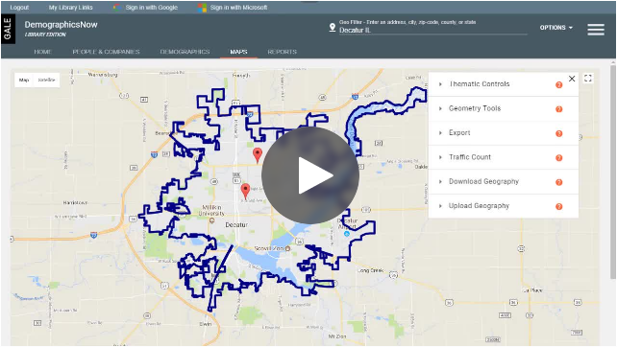
Choosing a Business Location

Slide 18
Use the database:
Let’s
Go!

Slide 19
Questions?

Slide 20
AskUs
918-549-7323
askus@tulsalibrary.org

Slide 21
Heather.Lozano@tulsalibrary.org
918-549-7429
wizard@tulsalibrary.org
918-549-7431
AskUs
918-549-7323

Slide 22
