Slide 2
So on Brand
Marketing and Branding

Slide 4
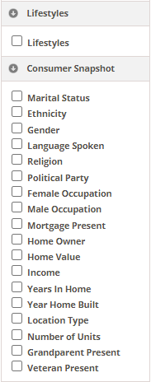
Find consumer and lifestyle data
Generate contact lists specific to your consumer base
Narrow search by zipcode

Slide 5
Begin by selecting advanced search
Click geography boundaries
Select income information

Slide 6
Chose lifestyles factors

Slide 7
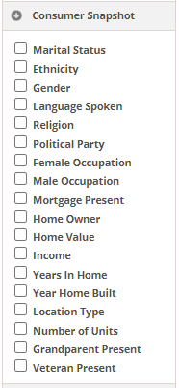
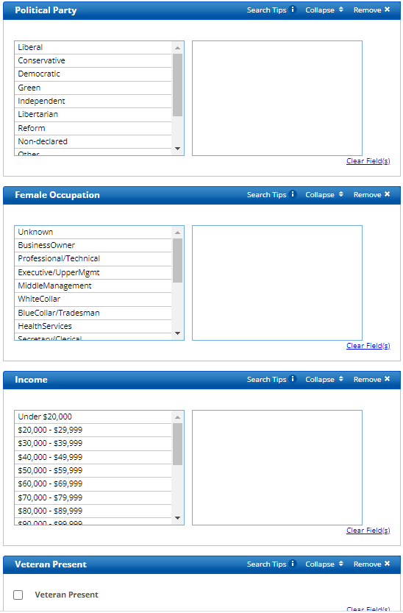
Select consumer information

Slide 9
Demographics

Slide 10
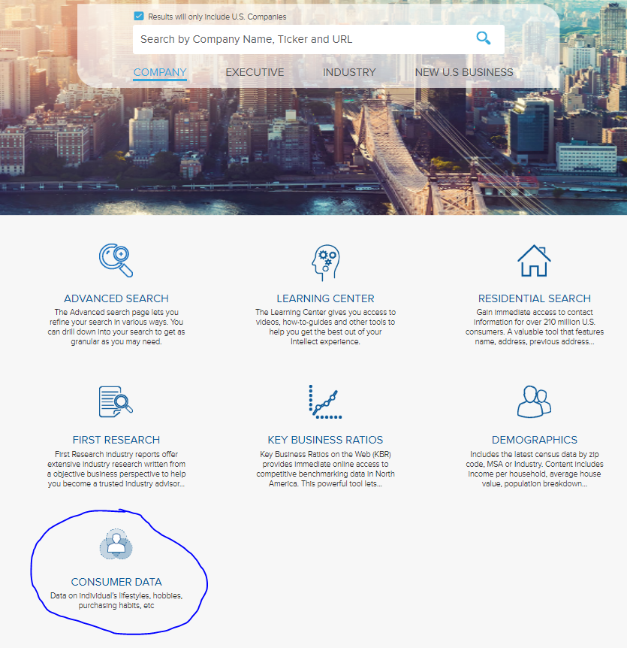
Select Consumer Data on the home page of Mergent Intellect

Slide 11
Consumer Lifestyle

Slide 12
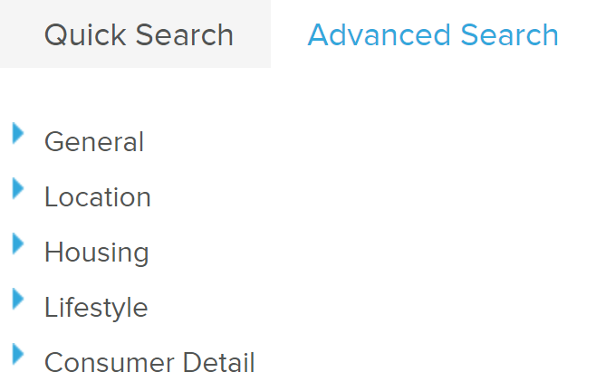

Slide 13
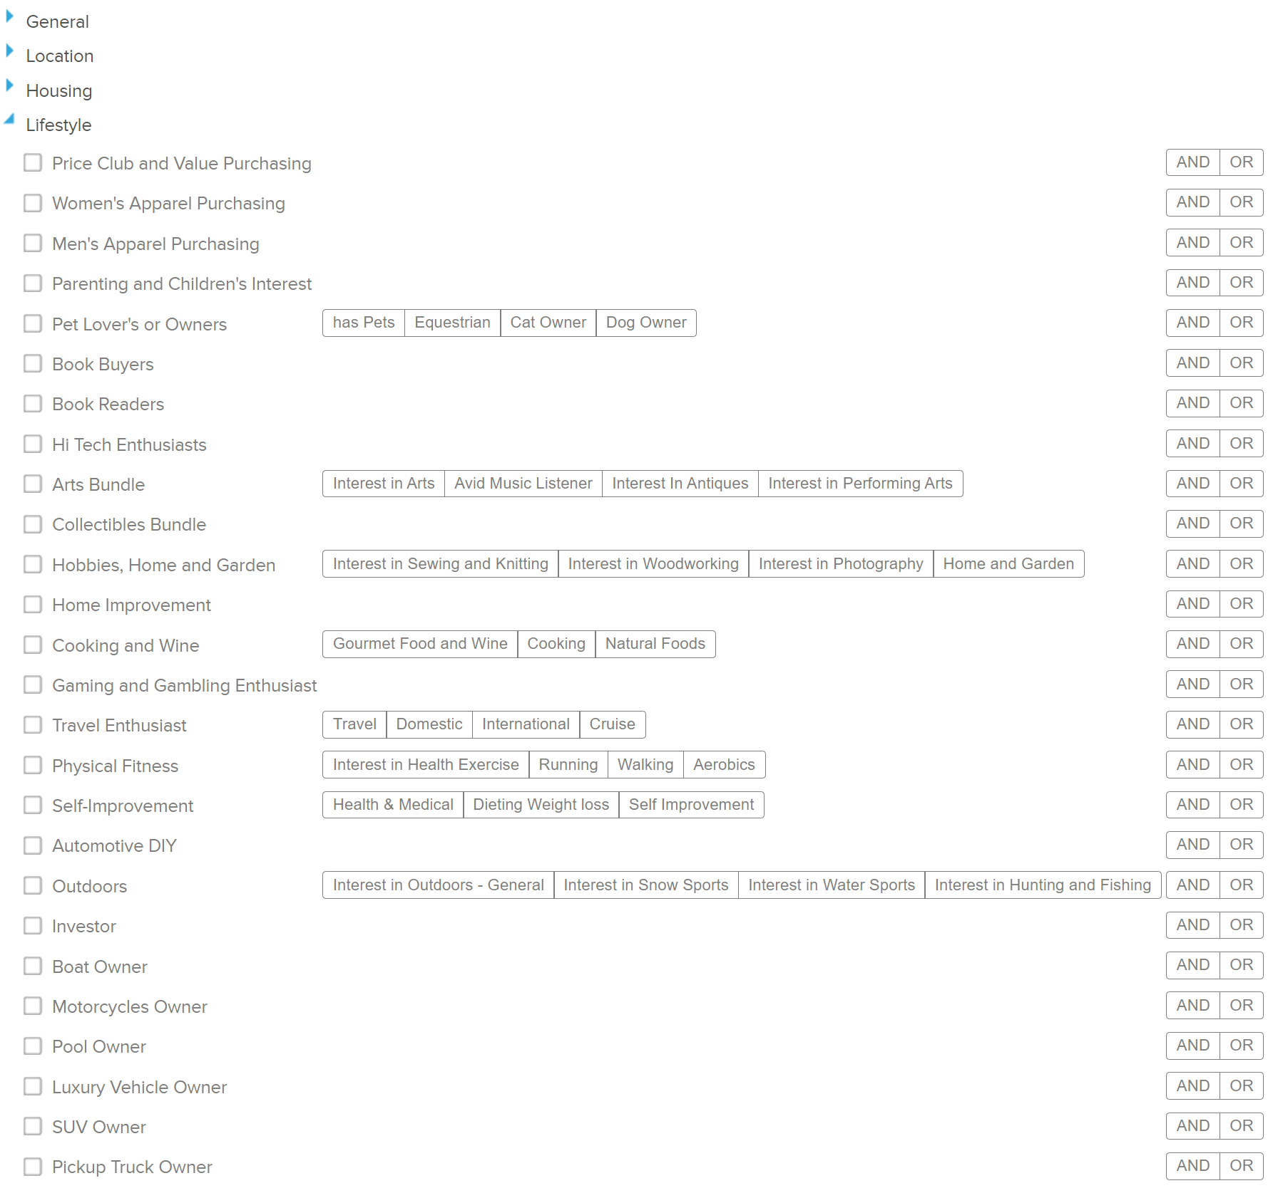

Slide 14
Mergent Intellect
Pulls up granular information about purchasing habits and lifestyle
Allows you to export the first 2,000 results

Slide 16
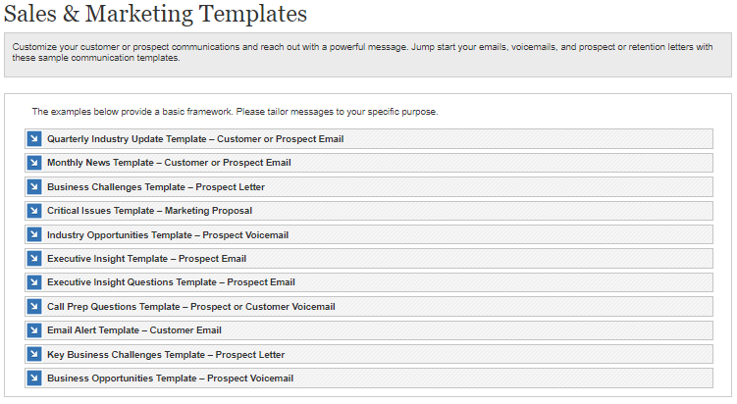
First Research/Dun & Bradstreet
Find communication templates to assist in your marketing
Templates should be altered to be specific to your business.

Slide 17
Other Resources
Maker Space
Digital Literacy Lab
Events related to marketing

Slide 18
AskUs
918-549-7323
askus@tulsalibrary.org

Slide 19
Questions?

Slide 20
Aubrey.naiman@tulsalibrary.org
918-549-7429
AskUs
918-549-7323

Slide 21
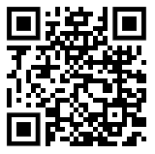
Please fill out this survey!

